Slide 1
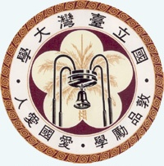
Color and Color Space
Presenter: Cheng-Jin Kuo
Advisor: Jian-Jiun Ding, Ph. D.
Professor
Digital Image & Signal Processing Lab
Graduate Institute of Communication Engineering
National Taiwan University, Taipei, Taiwan, ROC

Slide 2
Outline
Introduction
Additive Color Mixing
Subtractive Color Mixing
Newton Color Circle & Maxwell Triangle
System of Color Measurement
Color Space

Slide 3
1.Introduction
Three Characteristics of Color:
hue
brightness: the luminance of the object
saturation: the blue sky

Slide 4
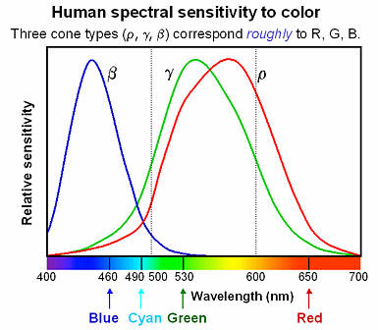
1.Introduction
Wavelength of the light

Slide 5
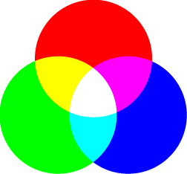
2.Additive Color Mixing
The mixing of “light”
Primary: Red, Green, Blue
The complementary color
“White” means

Slide 6

2.Subtractive Color Mixing
The mixing of “pigment”
Primary: Cyan, Magenta, Yellow
The complementary color
Why black?

Slide 7
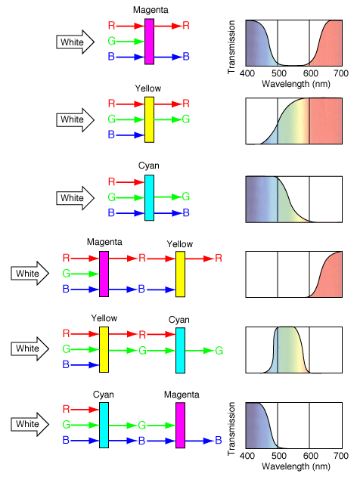
2.Subtractive Color Mixing
Why?
Pigments absorb light
Thinking:
the Color Filters
Question:
Yellow + Cyan=?

Slide 8
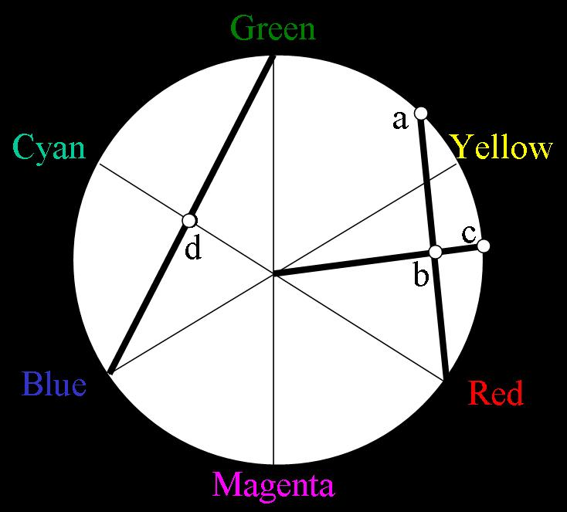
3.Newton Color Circle
Newton Color Circle
A tool to predict color mixing
hue :
saturation :

Slide 9
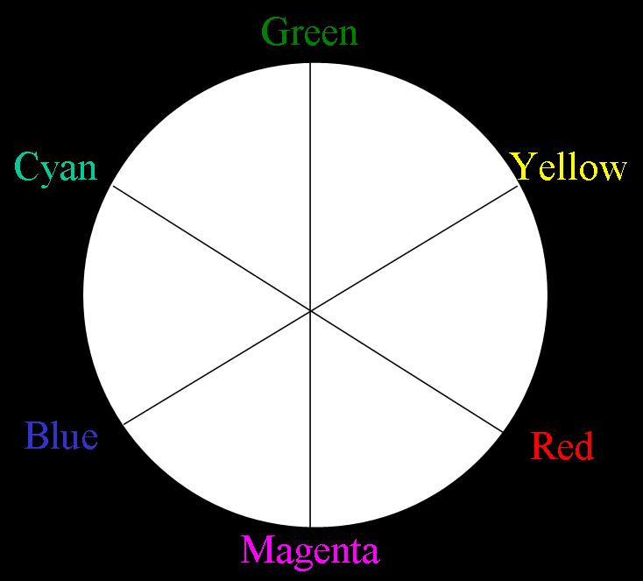
3.Newton Color Circle
Full saturated
Question:
How do we make a color having the same saturation as Cyan does?

Slide 10
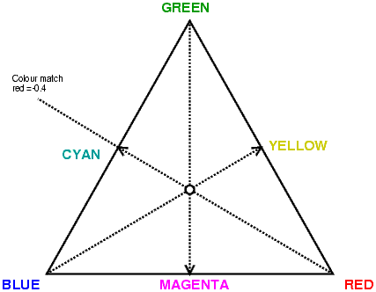
4.Maxwell Triangle
Connecting the GB
The negative component of Red?

Slide 11
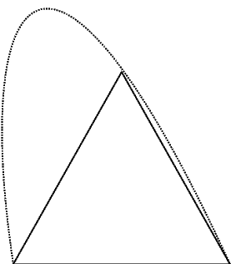
4.Maxwell Triangle
Spectral Locus
Spectral Color
Full saturated color

Slide 12
5.The CIE System
CIE 1931 XYZ system
One of the color spaces
The first mathematical defined color space
Three parameter:
X, Y, Z
or Y (brightness), x, y (chroma)

Slide 13
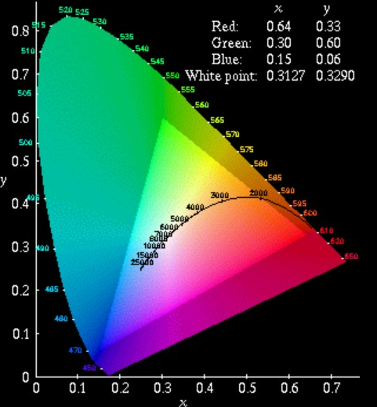
5.The CIE System
CIE Chromaticity Diagram
Spectral Locus
Parameter x, y

Slide 14
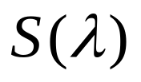
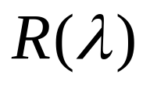
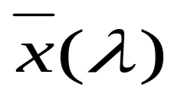
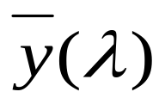
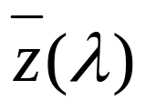
5.The CIE System
How do we get the parameters from a specified color or object?
The spectral power distribution of the illuminant:
spectral reflectance factor of the object :
Matching function:

Slide 15
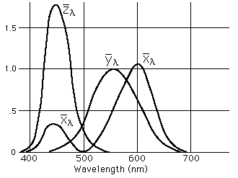
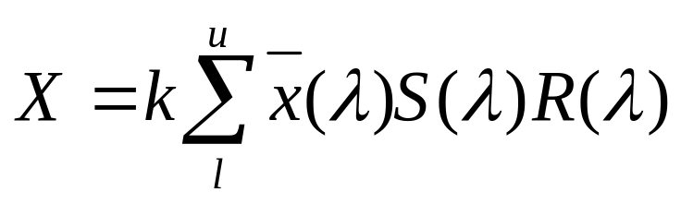
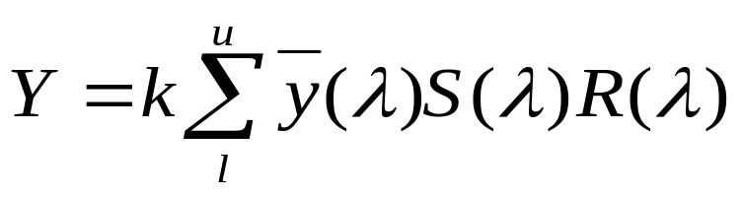
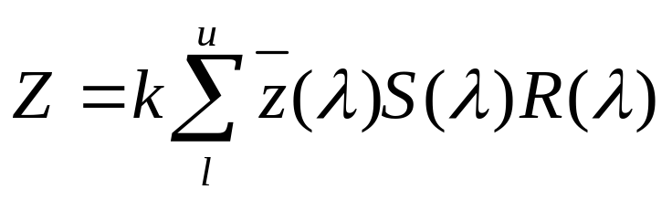
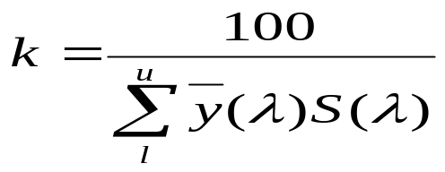
5.The CIE System

Slide 16
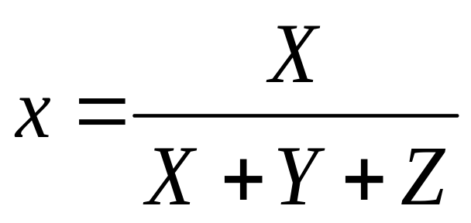
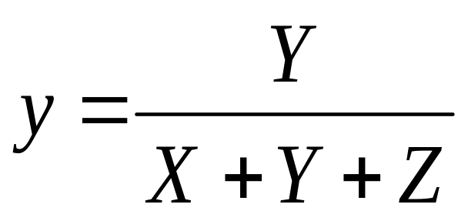
5.The CIE System
Y: the brightness
The chroma parameter x, y :

Slide 17
6.Color Measurement System
Why do we order colors?
Color Order system
Trichromatic theory by Hermann von Helmholtz
The concept of color space
So what are the three parameters?

Slide 18
6.Color Measurement System
Color order systems:
Munsell Color System
Natural Color System(NCS)

Slide 19
7.Munsell Color System
One of the Oldest color order systems
The three main parameters:
Munsell Hue (H) :
five primary:5R, 5Y, 5G, 5B, 5P
Munsell Value (V) :
the brightness scale from 0(black)~10
Munsell Chroma (C) :
from /0~/14

Slide 20
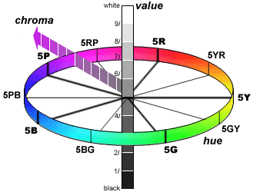
7.Munsell Color System
The examples of color expression:
5GY 8/2 :
Hue:5GY
Value:8
Chroma:2

Slide 21
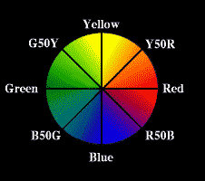
8.Natural Color System (NCS)
Six important value:
r, y, g, b, s (black), w (white)
Summing up the six values always get 100
Hue (Ф) :
Y90R : r=90%, y=10%
Blackness (s)
Chromaticness (c)
C=r + y + g + b

Slide 22
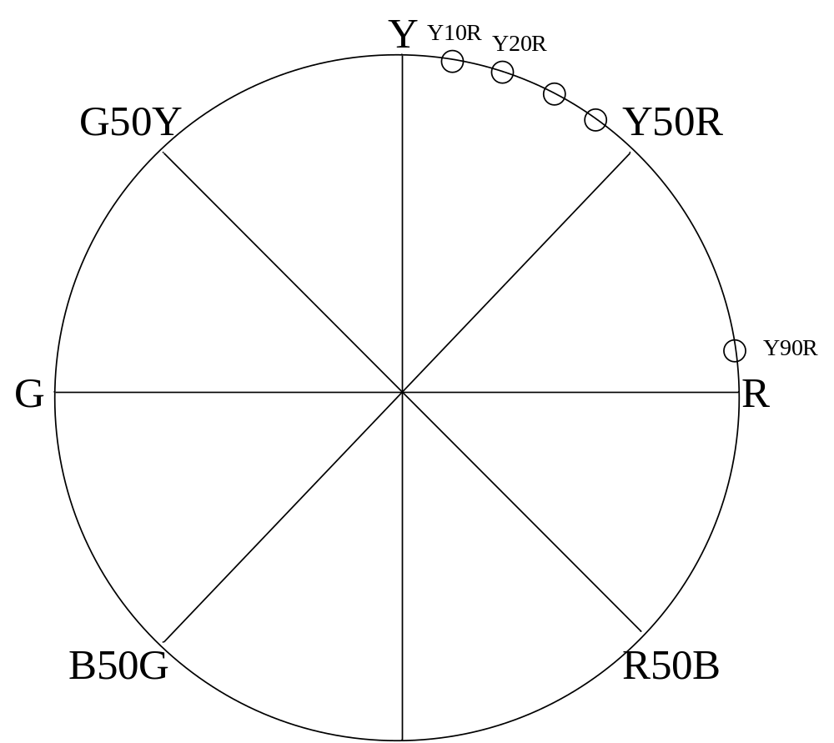
8.Natural Color System (NCS)

Slide 23
8.Natural Color System (NCS)
If the color data is: 10% whiteness
30% blackness
30% yellowness 30% redness
S=30, c=r+y=60
Ф=Y50R
→ 3060-Y50R

Slide 24
9.Color Space
Color Space:
RGB
YCbCr (YPbPr)
YUV
YIQ
CMYK
A comparison of them

Slide 25
9.Color Space
What is color space?
A 3D model used to define a specified color
The difference between color spaces:
The choice of axes

Slide 26
9.Color Space – RGB
RGB:
The simplest color space
Axes: Red, green, blue
Advantages: simple

Slide 27
9.Color Space – YCbCr &YPbPr
YCbCr & YPbPr
Used for: digital video encoding, digital camera
Axes:
Y: luma
Cb: blue chroma
Cr: red chroma

Slide 28
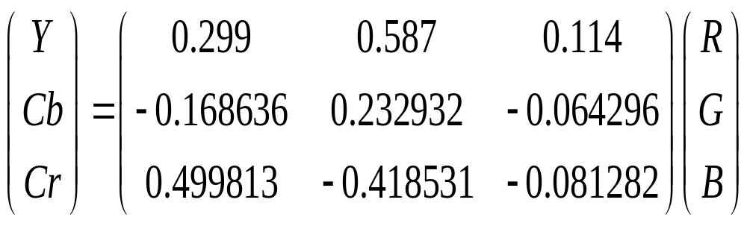
9.Color Space – YCbCr &YPbPr
Conversion from RGB:
Y=0.299(R-G) + G + 0.114(B-G)
Cb=0.564(B-Y)
Cr=0.713(R-Y)
The Matrix form:

Slide 29
9.Color Space – YCbCr &YPbPr
Why do we use the luma & chroma channel?
Advantage:
Bandwidth efficiency

Slide 30
9.Color Space – YUV
YUV
Used for: video encoding for some standard such as NTSC, PAL, SECAM
Axes:
Y: luma
U: blue chroma
V: red chroma

Slide 31
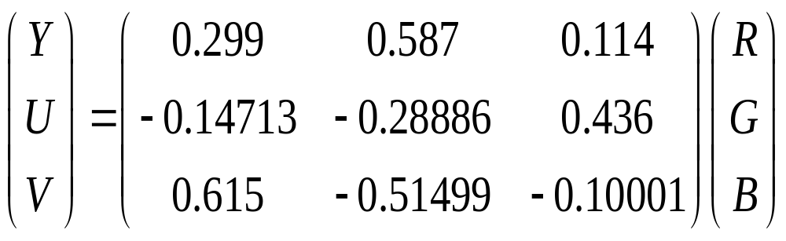
9.Color Space – YUV
Conversion from RGB:
Y=0.299R+0.587G+0.114B
U=0.436(B-Y)/(1-0.114)
V=0.615(R-Y)/(1-0.299)
The Matrix form:

Slide 32
9.Color Space – YIQ
YIQ
Used for: video encoding for some standard such as NTSC
Axes:
Y: luma
I: blue chroma
Q: red chroma
I-Q channels are rotated from the U-V channels in YUV

Slide 33
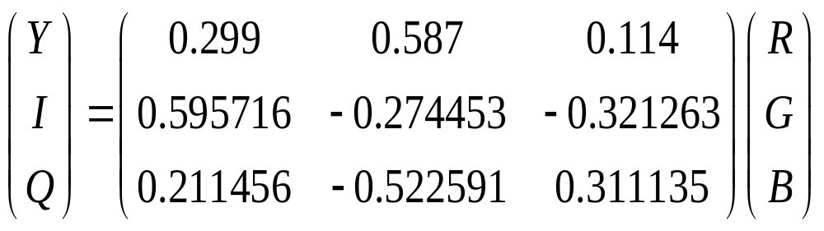
9.Color Space – YIQ
Conversion from RGB:

Slide 34
9.Color Space – CMYK
Used for: printer printing
Use the subtractive color mixing
Axes:
Cyan
Magenta
Yellow
K: black

Slide 35
9.Color Space – CMYK
Conversion from RGB:
C = 255 -Y - 1.4021(Cr-128)
M = 255 - Y + 0.3441(Cb-128) + 0.7142(Cr-128)
Y = 255 - Y - 1.7718(Cb -128)
K = min (C, M, Y)

Slide 36
9.Color Space – Comparison
Color space | Color mixing | Primary parameters | Used for | Pros and cons
RGB | Additive | Red, Green, Blue |  | Easy but wasting bandwidth
CMYK | Subtractive | Cyan, Magenta, Yellow, Black | Printer | Works in pigment mixing
YCbCr YPbPr | additive | Y(luminance), Cb(blue chroma), Cr(red chroma) | Video encoding, digital camera | Bandwidth efficient
YUV | additive | Y(luminance), U(blue chroma), V(red chroma) | Video encoding for NTSC, PAL, SECAM | Bandwidth efficient
YIQ | additive | Y(luminance), I(rotated from U), Q(rotated from V) | Video encoding for NTSC | Bandwidth efficient

Slide 37
References
[1] R. G. Kuehni, Color Space and Its Divisions, Wiley Inter-Science, 2002
[2] P. Green, L.MacDonald, Colour Engineering, Wiley, 2002
[3] R. W. G. Hunt, Measuring Colour, Ellis Horwood, 1995
[4] H. J. Durrett, Color and The Computer, Academic, 1987

